Slide 1
Ch 6: Bioinformatics Data
Chaochih Liu
November 15th, 2017

Slide 2
Overview
Retrieving data
Ensuring data integrity
Compression

Slide 3
Retrieving Data
Downloading large sequencing datasets
Accessing a web application hundreds of times to download specific files

Slide 4


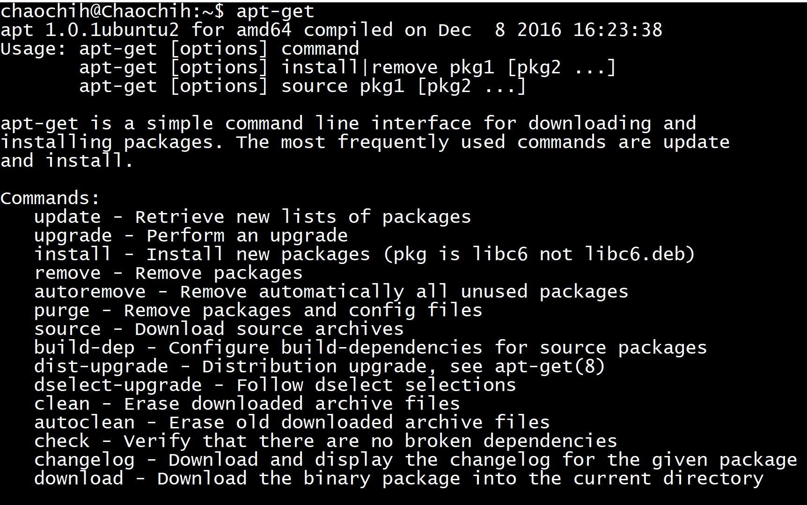
wget
Used to download data from the web to your server (i.e. MSI)
Depending on system, wget might not be already installed

Slide 5
wget
General command line syntax:
wget [url]
Example:
wget http://hgdownload.soe.ucsc.edu/goldenPath/hg19/chromosomes/chr22.fa.gz

Slide 6
wget
Can handle the following file links:
HTTP (Hyper-Text Transfer Protocol)
FTP (File Transfer Protocol)
Note: FTP is preferable to HTTP for large file

Slide 7
wget authentication
General syntax:
wget --user [username] --ask-password [url]

Slide 8
Downloading data recursively with wget
Download recursively:
wget --recursive [url]
or
wget -r [url]
Default, follow five links deep
Customize with -l or --level option

Slide 9
Downloading data recursively with wget
Example:
--accept only allows wget to download files matching pattern
--no-directories don’t create directories
--no-parent prevents wget from downloading pages higher in directory structure

Slide 10
Be careful!
wget’s recursive downloading can be aggressive.
Can utilize a lot of network resources and overload remote server.
Remote server may block your IP address if you download too much too quickly.

Slide 11
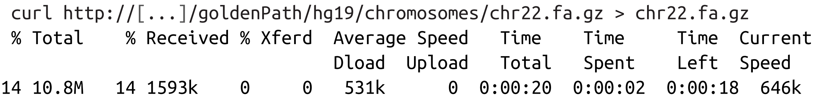
curl
Similar to wget but by default writes to standard output.
Can also use -O [filename] instead of redirecting output to file.

Slide 12
Advantages of curl
Can use more protocols than wget, such as:
SFTP (secure FTP)
SCP (secure copy)
HTTP
...and many more!
Use the -L or --location option to follow page redirects.

Slide 13
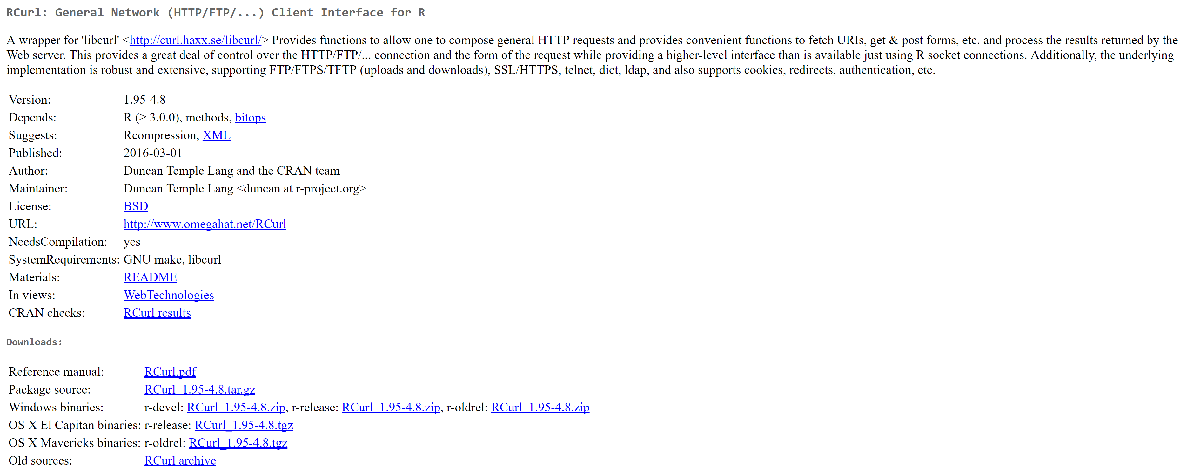
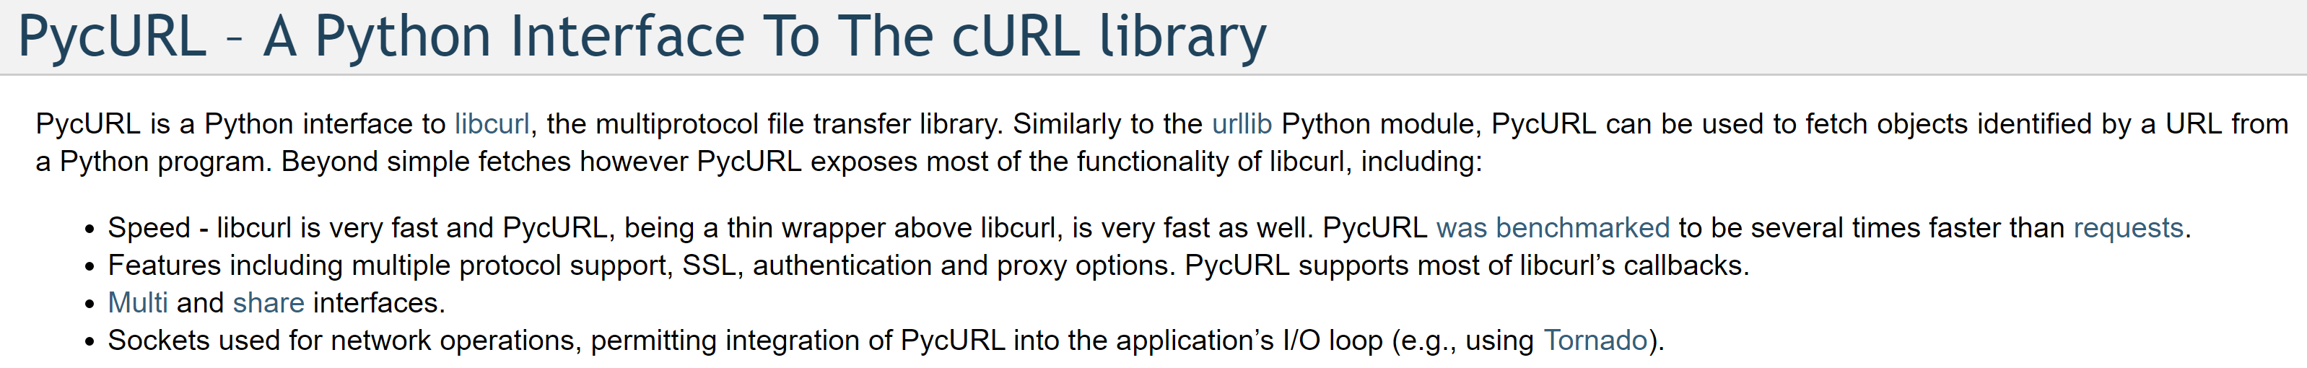
curl is also a library
Functionality is wrapped by software libraries:
RCurl
pycurl

Slide 14
Rsync
Good for heavier-duty tasks (i.e. transferring large sequencing datasets)
Often faster, only sends differences between file versions
Can compress files during transfers
Archive option that preserves links, modification timestamps, permissions, ownership, and other file attributes

Slide 15
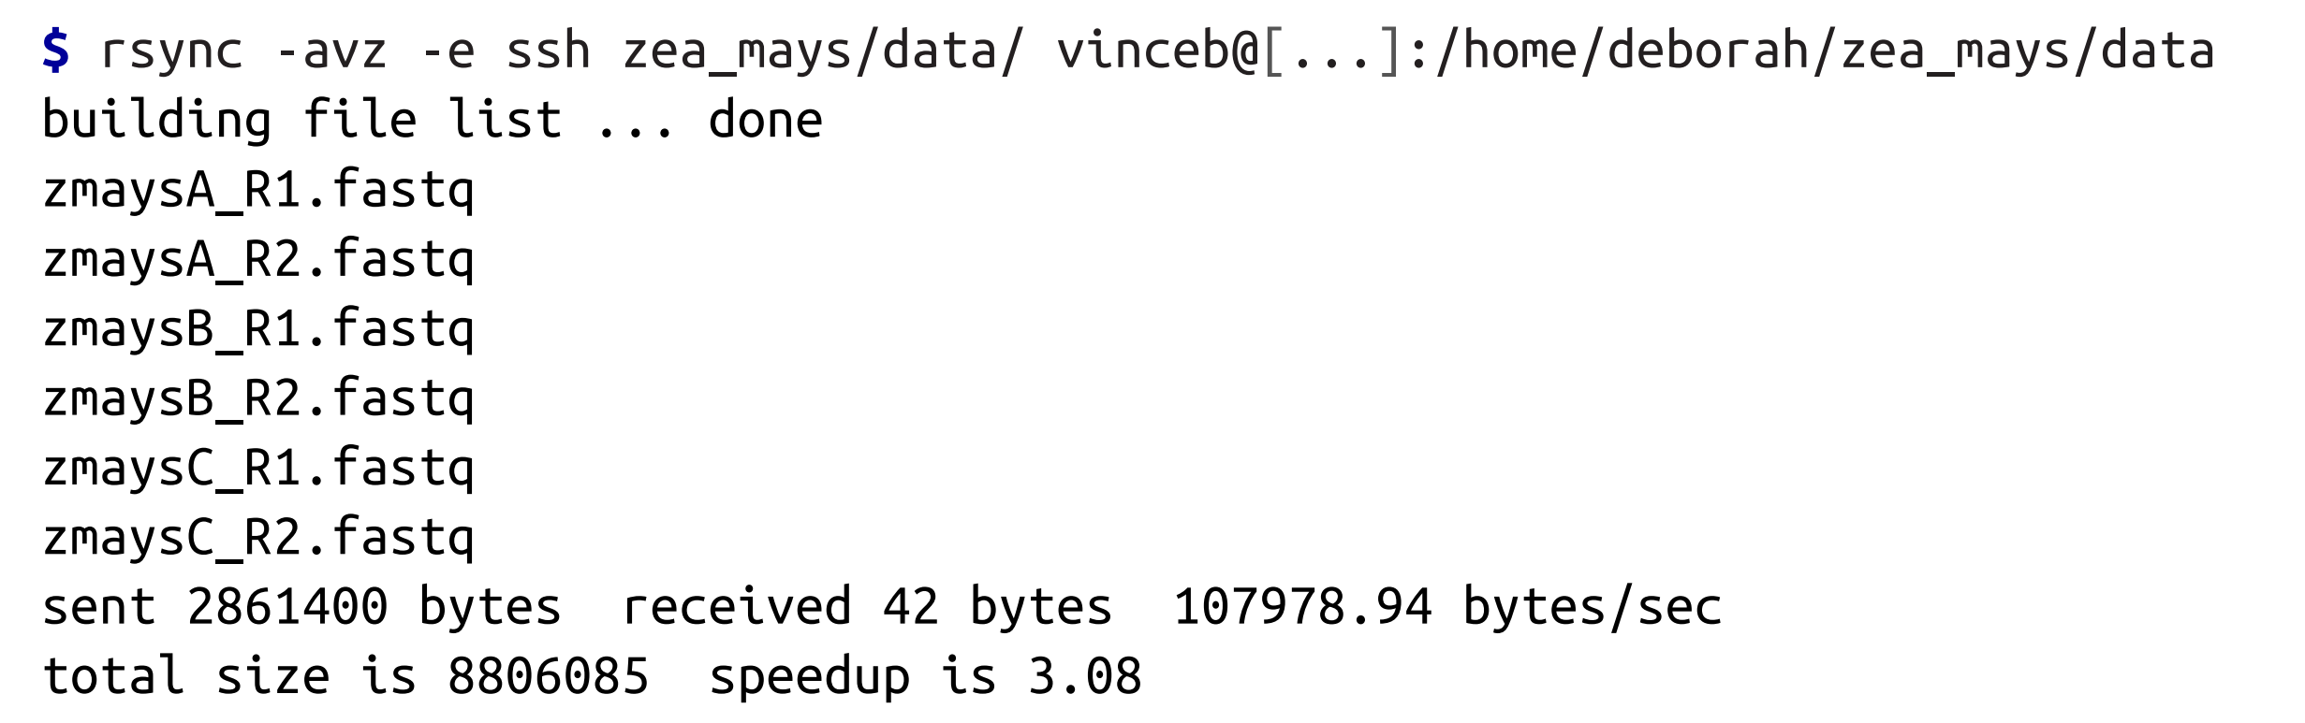
Rsync
-a option enables rsync’s archive mode
-z enables file transfer compression
-v allows you to see transfer progress
-e allows you to connect to remote host through SSH

Slide 16
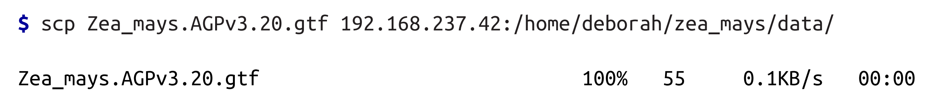
scp
Used to quickly copy a single file over SSH.

Slide 17
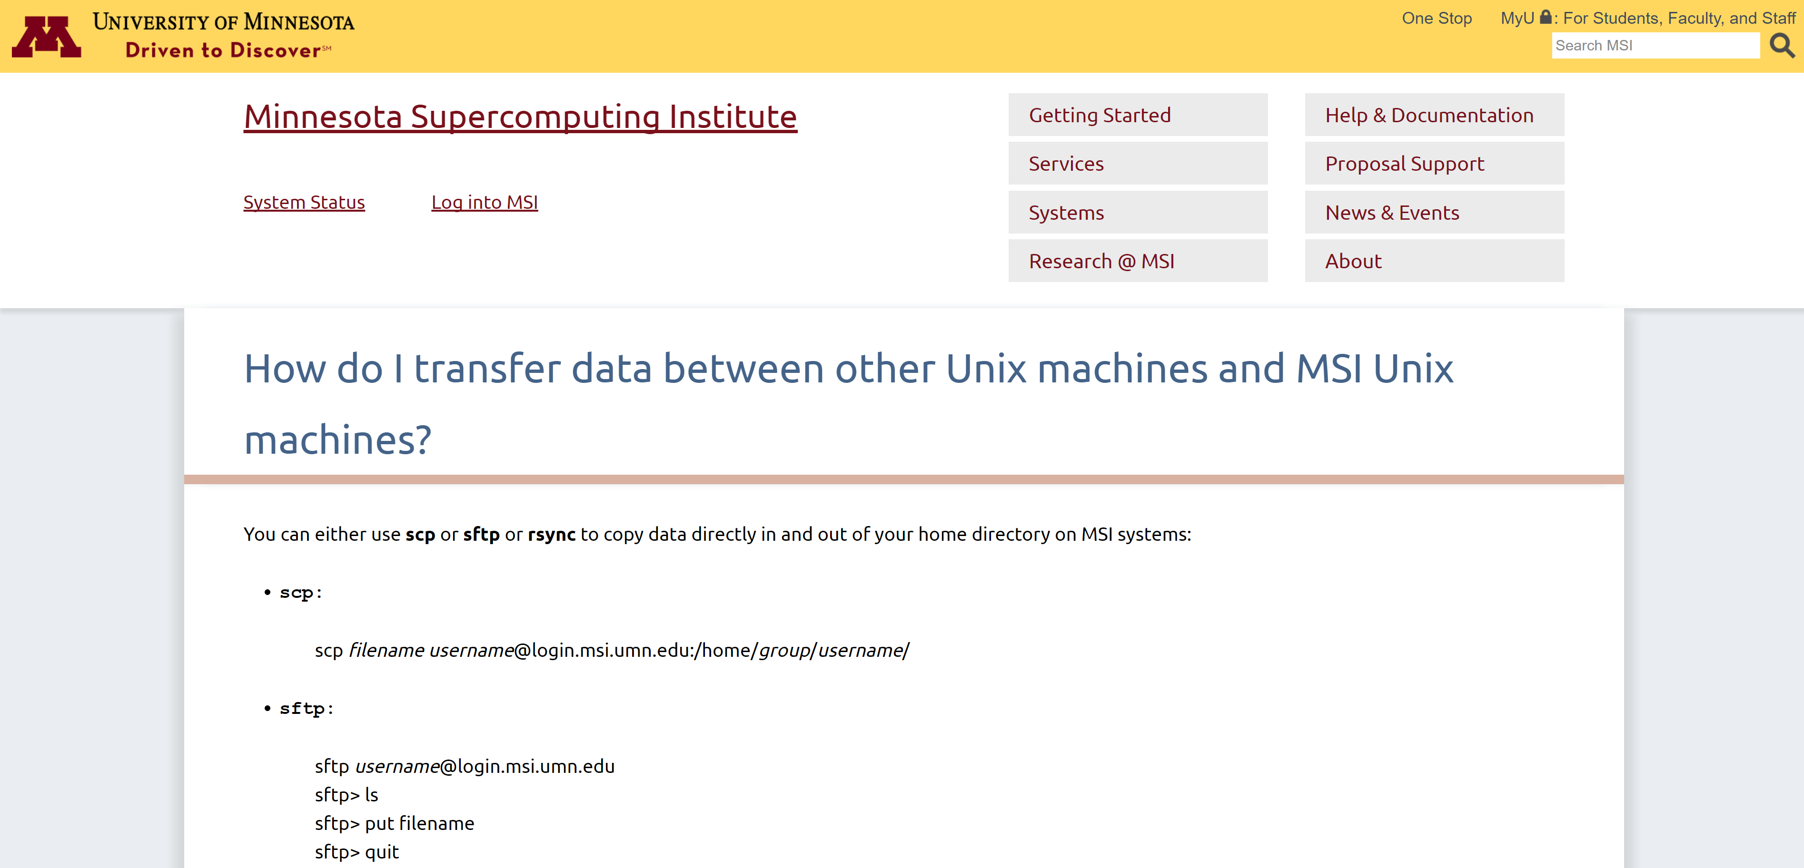

Slide 18
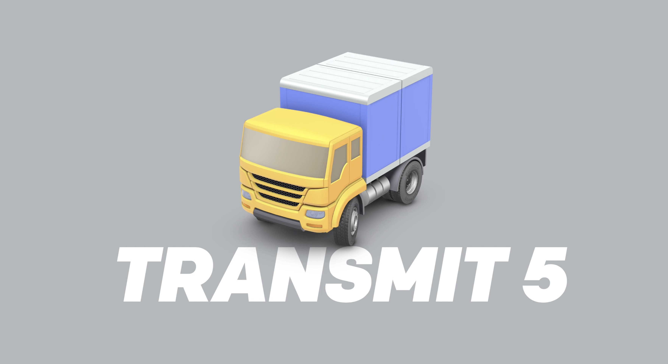

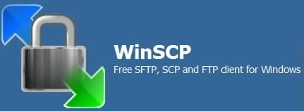
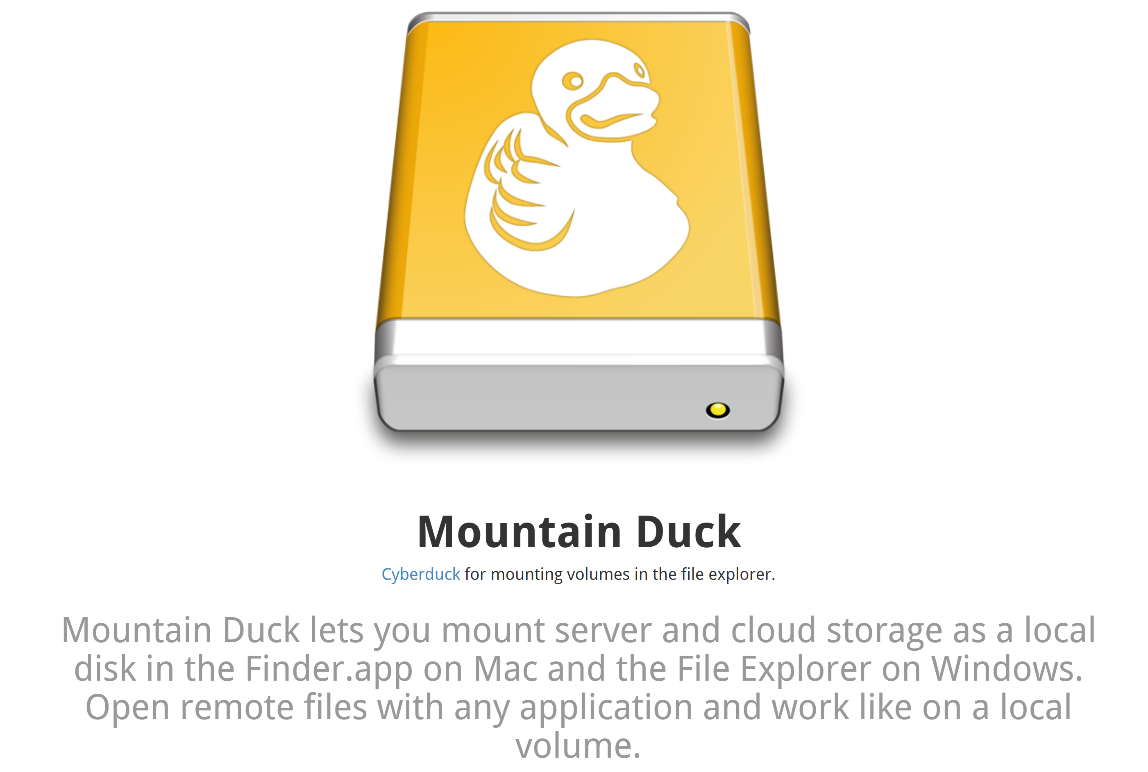

GUIs for transferring data

Slide 19
Ensuring Data Integrity
Transferring large datasets across networks
Opportunities for data corruption
Using correct version of data in analyses

Slide 20
Checksums
Compressed summaries of data
If one bit of data changes, the checksum value changes
SHA-1 and MD5 algorithms

Slide 21
SHA-1 Checksums
Same checksum algorithm used by Git to commit IDs

Slide 22
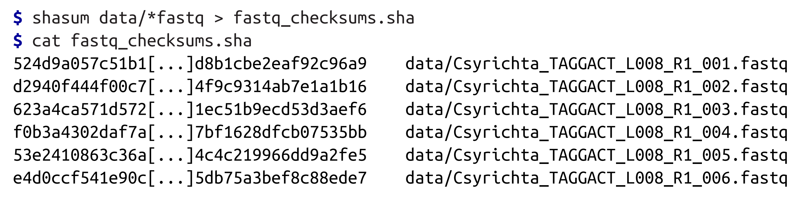
SHA-1 Checksums
Create a SHA-1 checksum file:

Slide 23
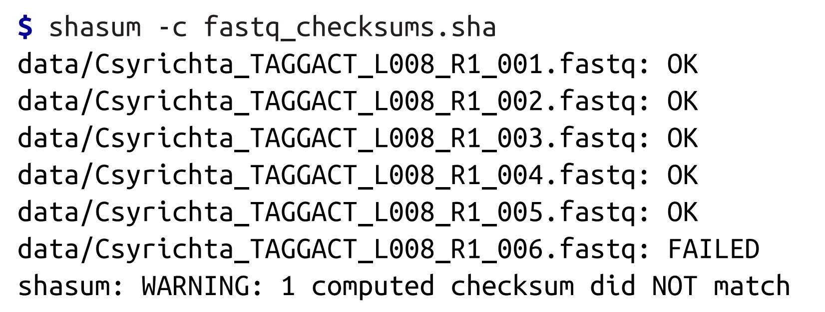
SHA-1 Checksums
Validate that files match original:

Slide 24
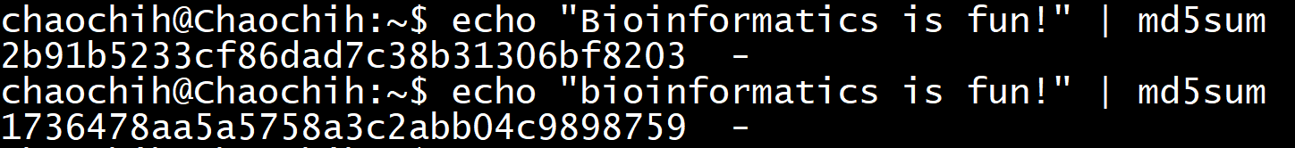
MD5 Checksums
Linux (i.e. MSI)
md5sum
OS X (doesn’t have -c option)
md5

Slide 25
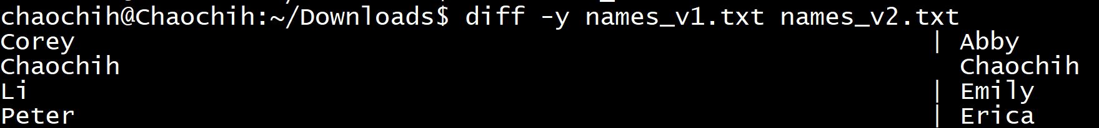
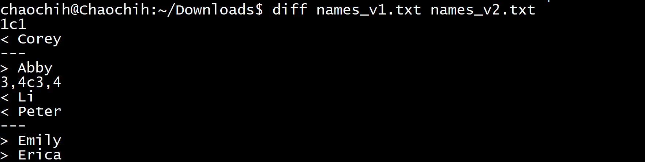
diff
Check how files are different

Slide 26
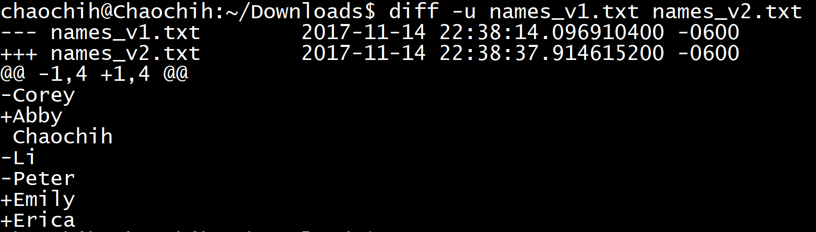
diff
Use -u option to output unified diff format
(format nearly identical to git diff)

Slide 27
Compression
Data in bioinformatics is often large
Needs to be compressed
Need to work with compressed data

Slide 28
gzip and bzip2
gzip compresses/decompresses faster
bzip2 has higher compression ratio (saving more space) – more common for long-term data archiving
Tools behave similarly.

Slide 29
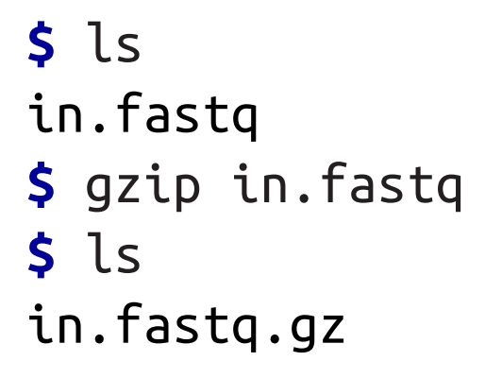
gzip
Takes in standard input
Compress files on disk in place (generally we don’t want to do this with raw data)

Slide 30
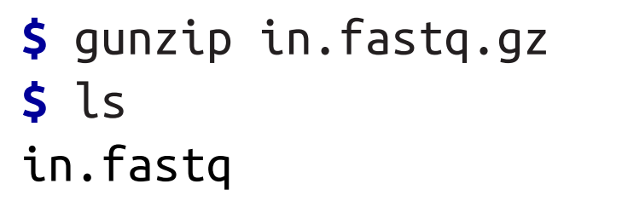
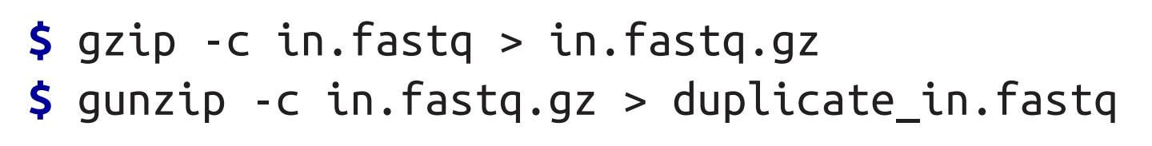
gunzip and gzip
Notes:
-c option means standard output

Slide 31
tar and gzip
Compress multiple separate files into single archive:
tar -czvf name-of-archive.tgz /path/to/directory-or-file
-c creates archive
-z compresses archive with gzip
-v displays progress in terminal while creating archive
-f allows you to specify filename of archive

Slide 32
tar and gzip
List (view) all files in archive.tar verbosely but don’t unpack
tar -tvf archive.tar
Unpack file
tar -xzvf file.tar.gz
Notes:
-t lists contents of an archive
-x extracts files from archive

Slide 33
Working with gzipped compressed files
grep for gzipped files: zgrep
cat for gzipped files: zcat or gzcat
diff for gzipped files: zdiff
less for gzipped files: zless

Slide 34
Discussion
What is your strategy for archiving large datasets?
What is your strategy for verifying data integrity when archiving large datasets?
How do you currently transfer data between a remote server (MSI) and your computer/another server?

